Slide 1
Industrial Human Resource Geo-Visualization
Domain - Resource Management

Slide 2
Problem Statement:
In India, the industrial classification of the workforce is essential to understand the distribution of the labor force across various sectors. The classification of main workers and marginal workers, other than cultivators and agricultural laborers, by sex and by section, division, and class, has been traditionally used to understand the economic status and employment trends in the country. However, the current data on this classification is outdated and may not accurately reflect the current state of the workforce. The aim of this study is to update the information on the industrial classification of the main and marginal workers, other than cultivators and agricultural laborers, by sex and by section, division, and class, to provide relevant and accurate data for policy making and employment planning.

Slide 3
Tools Used :
* Data Collection and Preparation - (Python, Pandas, NumPy)
* Exploratory Data Analysis (EDA) - (Pandas, Matplotlib, Seaborn)
* Visualization - (Plotly , Plotly Express)
* Natural Language Processing (NLP) - (NLTK , Spacy, Vectorizier)
* Machine Learning - (Scikit-learn, K-means, Clustering)
* Deployment – (Streamlit)

Slide 4
Approaches :
1. Data Collection and Integration : Collect All datasets and merge datasets into a DataFrame.
2. Data Cleaning and Preprocessing : Handling Missing Values, Data Normalization and Data Transformation.
3. Exploratory Data Analysis (EDA) : Descriptive Statistics, Visual Analysis, Correlation Analysis.
4. Natural Language Processing (NLP) :
Text Data Collection, Text Preprocessing , Stop Words and Vectorizier.
5. Machine Learning and Predictive Analysis :
Feature Engineering, Model Selection, Model Training and Validation, Predictive Insights.
6. Deployment : Using Streamlit to visualization and a Dashboard app in discuss figures for the Business Problems.

Slide 5
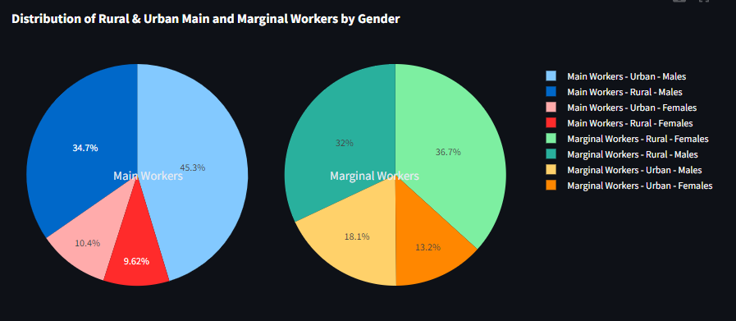
EDA Insights :

Slide 6
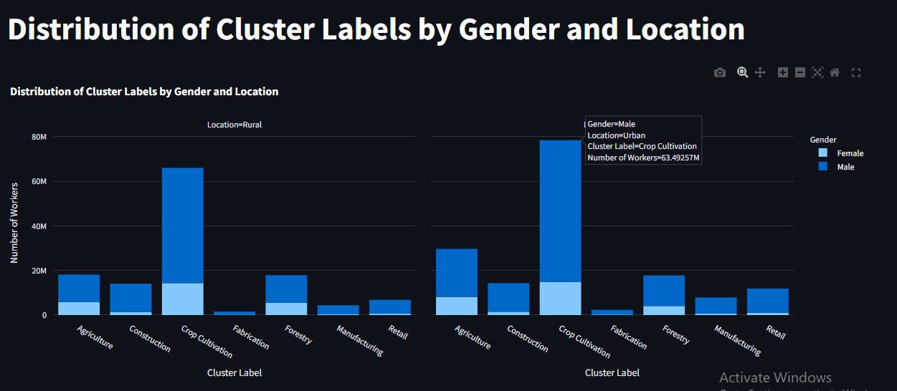

Slide 7
